Slide 1

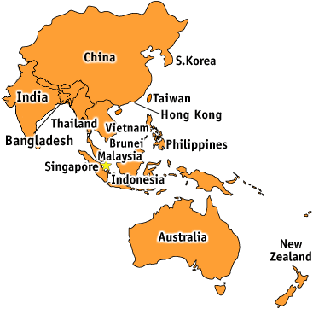
International Lift Expo – Korea 2021
APAC - Lift and Escalator Statistics

Slide 2
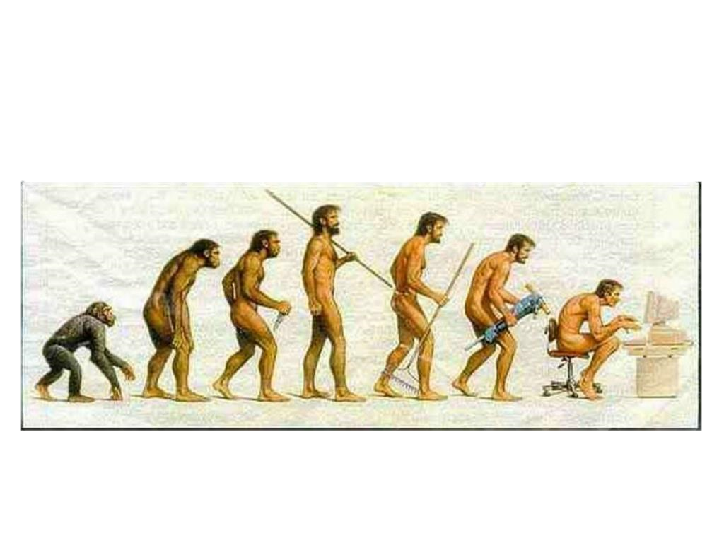
Population and Urbanization - Total Asia
Main driver for the Lift and Escalator market is Population and Urbanization
World Population Total Asian Population
    1950 : 2.556 billion 1.405 billion (55%)
    2020 : 7.800 billion 4.641 billion (59%)
    http://www.worldmeters.info/world-population
15-09 -2021 Graham Worthington 1
It took over 2 million years of human prehistory and history to reach 1 billion people and only 200 years more to reach 7 billion.
http://www.who.int/gho/urban
Jack Hammer invented
172 years ago
1st Safety Lift invented
168 years ago
Steam Engine invented
218 years ago
1 billion people 6 billion people
2,000,000 years 200 years

Slide 3
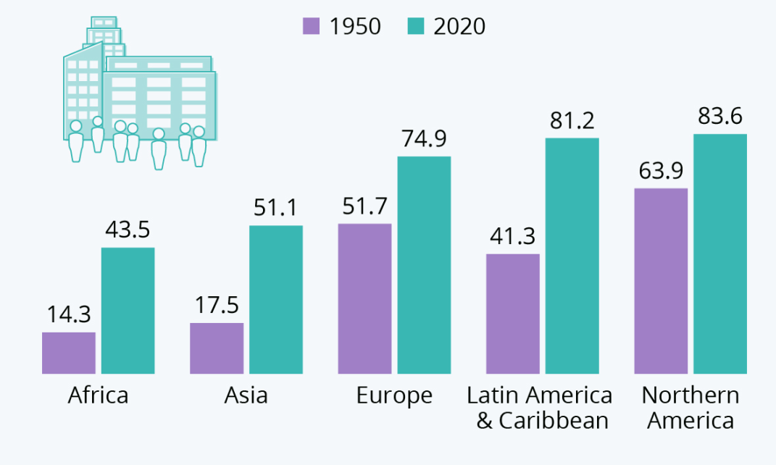
Population and Urbanization - Total Asia
Urbanization – “a population shift from rural to urban areas”.
http://www.unhabitat.org
15-09 -2021 Graham Worthington 2
31%
45%
97%
200%
200%

Slide 4
% Urbanization 2020 – APAC
15-09-2021 Graham Worthington 3

Slide 5
Population and Urbanization APAC
Population 2018 & 2020
Urbanization 2020
15-09-2021 Graham Worthington 4
 | Country | 2018 | 2020 | Delta | % |  |  | Country | Population | Urbanized | %
 | Macau | 642,090 | 649,335 | 7,245 | 1.1 |  |  | Macau | 649335 | 649335 | 100
 | New Zealand | 4,783,200 | 4,822,233 | 39,033 | 0.8 |  |  | New Zealand | 4822233 | 4147120 | 87
 | Singapore | 5,638,676 | 5,685,800 | 47,124 | 0.8 |  |  | Singapore | 5685807 | 5685807 | 100
 | Hong Kong | 7,475,000 | 7,496,981 | 21,981 | 0.3 |  |  | Hong Kong | 7496981 | 7496981 | 100
 | Taiwan | 23,758,247 | 23,816,775 | 58,528 | 0.2 |  |  | Taiwan,China | 23816775 | 18815252 | 79
 | Australia | 25,016,600 | 25,499,884 | 483,284 | 1.9 |  |  | Australia | 25499884 | 21929900 | 86
 | Malaysia | 32,382,300 | 32,657,290 | 274,990 | 0.8 |  |  | Malaysia | 32657290 | 25146113 | 77
 | Korea | 51,171,760 | 51,269,185 | 97,425 | 0.2 |  |  | Korea | 51269185 | 41528040 | 81
 | Thailand | 69,306,160 | 69,799,978 | 493,818 | 0.7 |  |  | Thailand | 69799978 | 35597989 | 51
 | Vietnam | 97,429,100 | 97,338,579 | -90,521 | -0.1 |  |  | Vietnam | 97338579 | 36015274 | 37
 | Philippines | 108,106,300 | 109,581,078 | 1,474,778 | 1.4 |  |  | Philippines | 109581078 | 51503107 | 47
 | Japan | 126,220,000 | 126,476,461 | 256,461 | 0.2 |  |  | Japan | 126476461 | 116358344 | 92
 | Indonesia | 269,536,482 | 273,523,615 | 3,987,133 | 1.5 |  |  | Indonesia | 273523615 | 155908461 | 57
 | India | 1,368,737,000 | 1,380,004,385 | 11,267,385 | 0.8 |  |  | India | 1380004385 | 483001535 | 35
 | China | 1,427,647,786 | 1,439,323,776 | 11,675,990 | 0.8 |  |  | China | 1439323776 | 877987503 | 61
 | Total | 3,617,850,701 | 3,647,945,355 | 30,094,654 | 0.8 |  |  | Total | 3647945362 | 1881770761 | 51.5
https://www.worldometers.info>world-population>asia

Slide 6
Market Growth Drivers in APAC
APAC is the Major Generating Region followed by Europe & North America
Population , Urbanization and Tourism Growth contributes to:
    Residential High-Rise Apartments
    Business and Commercial High – Rise
    Retail Malls and Shopping Centers
    Hotel Chains
    Efficient Mass Rapid Transport Systems (Metro’s)
    Airports and High-Speed Railway Systems
    Sustainable Infrastructure – “Smart Cities”
15-09-2021 Graham Worthington 5

Slide 7


Lift and Escalator Market Data
Australia Population : 25,499,884
Urbanization: 86%
P. I Index : 118
Installed Units 2020 Forecast Units 2021
Elevators : 205,504 6,578
Esc/MW : 10,609 212
New Zealand Population : 4,822,233
Urbanization: 87%
P. I Index : 253
Installed Units 2020 Forecast Units 2021
Elevators : 18,279 1,280
Esc/MW : 749 100
15-09-2021 Graham Worthington 6

Slide 8


Lift and Escalator Market Data
Hong Kong
Population : 7,496,981
Urbanization: 100%
P. I Index : 94
Installed Units 2020 Forecast Units 2021
Elevators : 70,000 2,100
Esc/MW : 10,000 500
India Population : 1,380,004,385
Urbanization: 35%
P. I Index : 2,430
Installed Units 2020 Forecast Units 2021
Elevators : 552,000 48,400
Esc/MW : 16,000 1,700
15-09-2021 Graham Worthington 7

Slide 9


Lift and Escalator Market Data
Indonesia Population : 273,523,615
Urbanization: 57%
P. I Index : 3,389
Installed Units 2020 Forecast Units 2021
Elevators : 71,500 5,300
Esc/MW : 9,200 600
Japan Population : 126,476,461
Urbanization: 92%
P. I Index : 119
Installed Units 2020 Forecast Units 2021
Elevators : 990,900 25,600
Esc/MW : 71,200 1,300
15-09-2021 Graham Worthington 8

Slide 10


Lift and Escalator Market Data
Korea Population : 51,269,185
Urbanization: 81%
P. I Index : 68
Installed Units 2020 Forecast Units 2021
Elevators : 713,000 31,500
Esc/MW : 36,800 1,800
Macau Population : 649,335
Urbanization: 100%
P. I Index : 71
Installed Units 2020 Forecast Units 2021
Elevators : 7,550 50
Esc/MW : 1,650 50
15-09-2021 Graham Worthington 9

Slide 11


Lift and Escalator Market Data
Malaysia Population : 32,657,290 Urbanization: 77%
P. I Index : 388
Installed Units 2020 Forecast Units 2021
Elevators : 70,520 N.E 3,490
Esc/MW : 13,655 N.E 341
Philippines Population : 109,581,078
Urbanization: 47%
P. I Index : 2,292
Installed Units 2020 Forecast Units 2021
Elevators : 43,000 N.E 2,100
Esc/MW : 4,800 N.E 300
15-05-2021 Graham Worthington 10

Slide 12


Lift and Escalator Market Data
Singapore Population : 5,685,807 Urbanization: 100%
P. I Index : 74
Installed Units 2020 Forecast Units 2021
Elevators : 70,000 2,560
Esc/MW : 7,000 210
Taiwan Population : 23,816,775
Urbanization: 79%
P. I Index : 108
Installed Units 2020 Forecast Units 2021
Elevators : 204,000 9,800
Esc/MW : 16,000 200
15-05-2021 Graham Worthington 11

Slide 13


Lift and Escalator Market Data
Thailand Population : 69,799,978
Urbanization: 51%
P. I Index : 844
Installed Units 2020 Forecast Units 2021
Elevators : 78,200 3,410
Esc/MW : 4,500 390
Vietnam Population : 97,338,579
Urbanization: 37%
P. I Index : 1,705
Installed Units 2020 Forecast Units 2021
Elevators : 47,000 5,340
Esc/MW : 10,100 150
15-09-2021 Graham Worthington 12

Slide 14

Lift and Escalator Market Data
China Population : 25,499,884
Urbanization: 61%
P. I Index : 167
Installed Units 2020 Forecast Units 2021
Elevators : 7,941,000 1,092,500
Esc/MW : 659,000 57,500
Others
Installed Units 2020 Forecast Units 2021
Elevators : 67,285 4,710
Esc/MW : 2,691 200
15-09-2021 Graham Worthington 13
15-09-2021 Graham Worthington 14

Slide 15
Lift and Escalator Installed & New 2020 - 2021
 | Country | Installed Units 2020 |  |  |  |  | New Units 2021
 |  | Lift | Esc. | Total |  |  | Lift | Esc. | Total
 | China | 7,941,000 | 659,000 | 8,600,000 |  |  | 1,092,500 | 57,500 | 1,150,000
 | Japan | 990,900 | 71,200 | 1,062,100 |  |  | 25,600 | 1,300 | 26,900
 | South Korea | 713,000 | 36,800 | 749,800 |  |  | 31,500 | 1,800 | 33,300
 | India | 552,000 | 16,000 | 568,000 |  |  | 48,400 | 1,700 | 50,100
 | Taiwan | 204,000 | 16,000 | 220,000 |  |  | 9,800 | 200 | 10,000
 | Australia | 205,504 | 10,609 | 216,113 |  |  | 6,578 | 212 | 6,790
 | Malaysia | 70,520 | 13,655 | 84,175 |  |  | 3,490 | 341 | 3,831
 | Thailand | 78,200 | 4,500 | 82,700 |  |  | 3,410 | 390 | 3,800
 | Indonesia | 71,500 | 9,200 | 80,700 |  |  | 5,300 | 600 | 5,900
 | Hong Kong | 70,000 | 10,000 | 80,000 |  |  | 2,100 | 500 | 2,600
 | Singapore | 70,000 | 7,000 | 77,000 |  |  | 2,560 | 210 | 2,770
 | Vietnam | 47,000 | 10,100 | 57,100 |  |  | 5,340 | 150 | 5,490
 | Philippines | 44,000 | 4,800 | 48,800 |  |  | 2,310 | 300 | 2,610
 | New Zealand | 18,279 | 749 | 19,028 |  |  | 1,280 | 100 | 1,380
 | Macau | 7,550 | 1,650 | 9,200 |  |  | 50 | 50 | 100
 | Others | 67,285 | 2,691 | 69,976 |  |  | 4,710 | 200 | 4,910
 | Total | 11,110,738 | 873,954 | 12,024,693 |  |  | 1,244,928 | 65,554 | 1,310,482
 | W/O China | 3,209,738 | 214,954 | 3,424,693 |  |  | 152,428 | 8,054 | 160,482
15-09-2021 Graham Worthington 14

Slide 16
Lifts and Escalators in Operation (est) - 2019
CEN / TC 10 Plenary Report 2020
PALEA Market Study 2021
36%
39%
37%
North America
7%
6%
39%
9%
7%
Europe, Russia,
Middle East, Africa
China
Japan and Korea
3%
7%
7%
3%
Rest of Asia Pacific
South America
CEN - Lifts and escalators in operation: ~17 million units (estimated)
***PALEA : ~ 19.6 million units (estimated)
*** Based on Elev. World Global Stats and China Growth
15-09-2021 Graham Worthington 15

Slide 17
Lifts and Escalator New Installations(est) - 2019
CEN / TC 10 Plenary Report 2020
PALEA Market Study 2021
2016 – 775,000
2017 – 807,000
2018 – 850.000
2019 – 980,000
3,412,000
70%
13%
168,040
North America
63%
2%
19%
3%
5%
23,832
5%
Europe, Russia,
Middle East, Africa
62,668
China
Japan and Korea
2%
8%
8%
102,919
2%
21,873
Rest of Asia Pacific
South America
CEN – New Lifts and Escalators : ~1 million units (estimated)
PALEA : ~ 1.359 million units (estimated)
Note: China Installations alone confirmed 980,000 units
15-09-2021 Graham Worthington 16

Slide 18
Lift and Escalator Summary - 2020 & 2021
Worldwide Installed Units 2020 : 21,055,388 (estimated)
Installed Units Asia Pacific : 3,424,693 (16% of Global Installations)
Installed Units China : 8,600,000 (41% of Global Installations)
Worldwide New Equipment 2021 : 1,533,326 (estimated)
Asia Pacific New Equipment 2021: 160,482 ( 11% of Global New Equipment)
China New Equipment 2021 : 1,150,000 ( 75% of Global New Equipment)
15-09-2021 Graham Worthington 17

Slide 19
Projected $ Market Growth in Asia Pacific
Global Elevator and Escalator Market Projected $ Value Growth
  2 Independent Market Researchers have similar numbers
    2021 – USD 117.5 Billion
    2024 - USD 154.9 Billion
    http://www.researchandmarkets.com/reports/5321787
    2021 – USD 119.9 Billion
    2024 - USD 154.6 Billion
    2027 - USD 183.5 Billion
    http://www.statista.com/statistics/261866/worldwide-sales
15-09-2021 Graham Worthington 18
Asia Pacific @ 11% Global Share
2021 – USD 13 Billion
2024 – USD 17 Billion
China @ 75% Global Share
2021 – USD 88 Billion
2024 – USD 116 Billion

Slide 20
Emerging APAC Markets
Country | Urban % | PI Index
Hong Kong | 100 | 94
Macau | 100 | 71
Singapore | 100 | 74
Japan | 92 | 119
New Zealand | 87 | 253
Australia | 86 | 118
Korea | 81 | 68
Taiwan | 79 | 108
Malaysia | 77 | 388
China | 61 | 167
Indonesia | 57 | 3389
Thailand | 51 | 844
Philippines | 47 | 2246
Veitnam | 37 | 1705
India | 35 | 2430
7,496,981
80,000
Population
Units
=
PI =
Emerging Markets
15-09-2021 Graham Worthington 19

Slide 21
Elevator and Escalator Market Estimates
Market and Statistics researched from multiple sources
Elevator World Global Statistics
Industry Members
National Regulators and Standards Bodies
Global Elevator and Escalator Associations
Consultants
Public web sites
15-09-2021 Graham Worthington 20

Slide 22

Thank you for your attention

